Slide 1
Mushrooms: Poisonous, Edible, or Unknown?
Matthew Borja

Slide 2
Purpose
Mushroom Data Set from UCI Machine Learning Repository
14,000 species of mushrooms we know of.
“Never eat a Mushroom unless you can positively identify it”
How do we know which mushrooms are safe to eat?
Machine Learning
Decision Tree Classification
Naïve Bayes Classifier

Slide 3
Data Set
8,124 instances in total
2,480 were missing an attribute
5,644 instances to be processed
22 attributes in total
Class is a binary value of “Edible” or “Poisonous”

Slide 4
Data Set: Attributes
Cap shape = {bell, conical, convex, flat, knobbed, sunken},
Cap surface = {fibrous, grooves, scaly, smooth},
Cap color = {brown, buff, cinnamon, gray, green, pink, purple, red, white, yellow},
Bruises = {T, F},
Odor = {almond, anise, creosote, fishy, foul, musty, none, pungent, spicy},
Gill attachment = {attached, descending, free, notched},
Gill spacing = {close, crowded, distant},
Gill size = {broad, narrow},
Gill color = {black, brown, buff, chocolate, gray, green, orange, pink, purple, red, white, yellow},
Stalk shape = {enlarging, tapering},
Stalk root = {bulbous, club, cup, equal, rhizomorphs, rooted},
Stalk surface above ring = {fibrous, scaly, silky, smooth},

Slide 5
Data Set: Attributes
13. Stalk surface below ring = {fibrous, scaly, silky, smooth},
14. Stalk color above ring = {brown, buff, cinnamon, gray, orange, pink, red, white, yellow},
15. Stalk color below ring = {brown, buff, cinnamon, gray, orange, pink, red, white, yellow},
16. Veil type = {partial, universal},
17. Veil color = {brown, orange, white, yellow},
18. Ring number = {none, one, two},
19. Ring type = {cobwebby, evanescent, flaring, large, none, pendant, sheathing, zone},
20. Spore print color = {black, brown, buff, chocolate, green, orange, purple, white, yellow},
21. Population = {abundant, clustered, numerous, scattered, several, solitary},
22. Habitat = {grasses, leaves, meadows, paths, urban, waste, woods}.
Class: Edible, Poisonous

Slide 6
Data Preprocessing
All attributes represented with letters originally
Missing Attributes represented with “?” in attribute 11
Needed to remove these ambiguous attributes and
Needed to process data into nominal format.
C++
Take in a string of characters, seek a position, replace that letter with a nominal number.
Do this for all 22 attributes and the class.

Slide 7
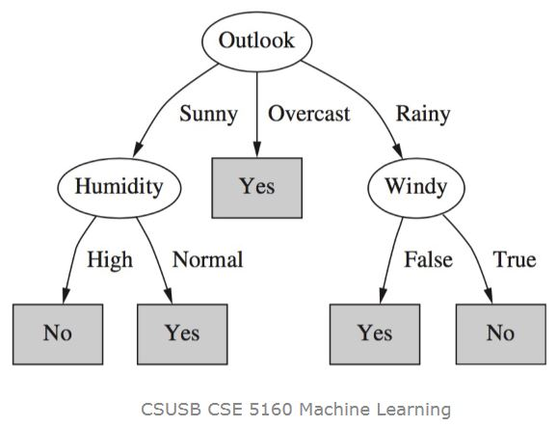
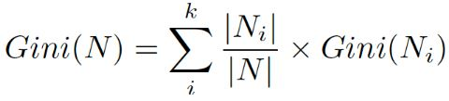
Decision Tree Classification
“Non-parametric supervised learning method for classification and regression”
Given x, a decision tree will predict output label y by traversing from root node to leaf node.
Purity: Gini Index:
Goal: Minimal Tree with purest possible leaf nodes.
Advantages: Inexpensive, extremely fast at classifying, easy to understand, robust to noise, and resilient in dealing with redundant/irrelevant attributes.
Disadvantages: Prone to overfitting, potentially grow exponentially if optimal tree not found, and unbalanced data sets can generate biased trees.

Slide 8
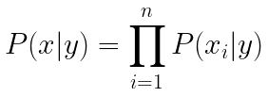
Naive Bayes Classifier
“Supervised machine learning algorithm used for classification tasks.”
Known as probabilistic classifier since it is based on Bayes’ Theorem
Given an input vector, predict an output label y of which the maximal probability of y is chosen.
Advantages: Robust to isolated noise points and ignores missing values
Disadvantages: If one of the conditional probabilities is zero, then the entire expression becomes zero.
Can use probability estimation techniques to work around this problem.

Slide 9
Experiment
Environment: Google Colab
Libraries: Numpy, matplotlib.pyplot, pandas, sklearn
Easy to use
Save my progress and results as I go
Access this from anywhere
Quick
DecisionTreeClassification()
CategoricalNB()

Slide 10
Experiment
Drop the y data from data set and move it to its own variable
X_train, X_test, y_train, y_test = train_test_split(X, y, test_size=#.#)
Decision Tree
dt.tree.DecisionTreeClassifier(max_leaf_nodes=##)
Naive Bayes
Clf = CategoricalNB()

Slide 11
Experiment: Important Values
Mean of the cross_val_score(x_train, y_train, cv=10)
y_pred
= dt.predict(X_test)
= clf.predict(X_test)
Test error = mean_squared_error(y_test, y_pred)
Test accuracy = accuracy_score(y_test, y_pred)
Score(X_test, y_test) for Naive Bayes
Y_predtrain = dt.predict(X_train)/=clf.predict(X_train)
Training error = mean_squared_error(y_train, y_predtrain)
Train accuracy = accuracy_score(y_train, y_predtrain)

Slide 12
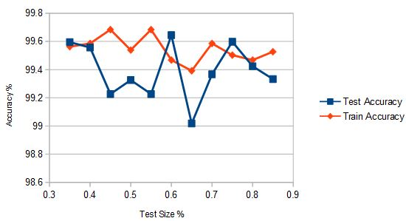
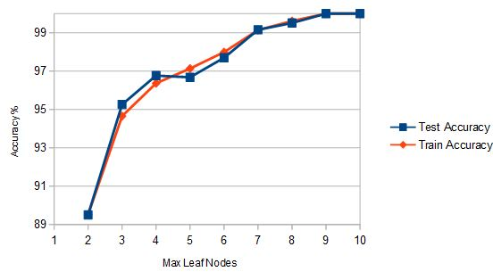
Decision Tree Results
Test Size made a big impact in accuracy results.
Various Test Sizes were taken to determine best fit.
Test Size 0.4 determined best.
Highest accuracies together
Smallest difference between accuracies
Next max leaf nodes
Limiting max leaf nodes resulted in a tree that was too simple. Intuitively, accuracies improved with more nodes.

Slide 13
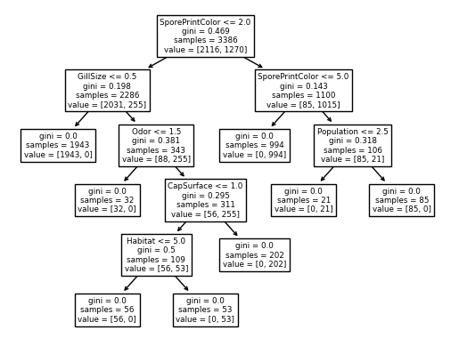
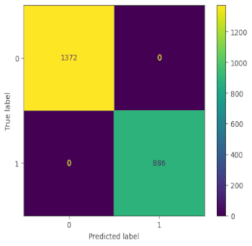
Decision Tree Results
Decision Tree decided the best splits were at Spore Print Color, Gill Size, Odor, Cap Surface, Population, and Habitat. 6 out of 22 attributes.
Would determine a stopping point at around 10-12 nodes with 100% accuracy.

Slide 14
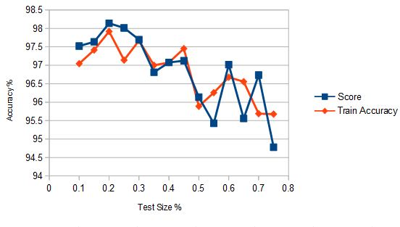
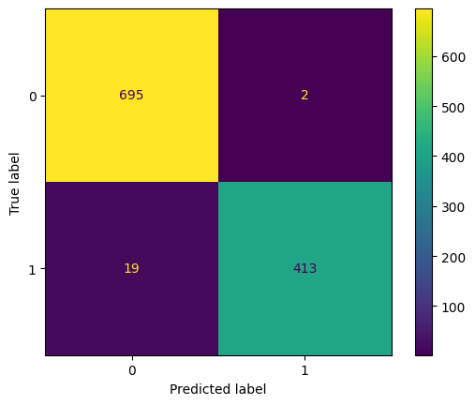
Naive Bayes Classifier Results
Fewer options for parameters than Decision Tree.
Test Size was experimented with.
Best results found at a test size of 20%.
Highest accuracy and smallest difference in accuracies
Score == Test Accuracy
At 20% test size:
Score: 98.139%
Training Accuracy: 97.918%
Mean cross_val_score: 97.563%

Slide 15
Comparison
Decision Tree accomplished a 100% test accuracy and training accuracy
100% Test Accuracy, 100% Training Accuracy at 10+ leaf nodes.
Mean Cross Validation of 1
Pure Leaf Nodes
Test Size of 40%
Naive Bayes came close with 98% test accuracy and 97% training accuracy.
98.139% Test Accuracy
97.918% Training Accuracy
Mean Cross Validation of 0.97563
Test Size of 25%

Slide 16
Conclusion
A perfect score leads to questions.
Removed data altered outcome?
At around 8-9 nodes, near perfect score.
Alternatively, the strengths of the decision tree pulled ahead of Naive Bayes.
Naive Bayes takes the Naive approach after all.
Great scores overall.
Would you trust a machine learning algorithm to recommend mushrooms?
Possible applications include assisting mycologists with determining new species of mushrooms poisonous qualities, or revising what we know about how phenotypes affect this classification.
Possible application: Cameras integrated with machine learning and robotic assembly to filter mushrooms in an industrial environment.

